Slide 1

Systems Engineering Comparison of Data-driven Fault Detection and Identification Methods for the Tennessee Eastman Process
5 February 2018

Slide 2
Fault Detection & Identification
Faults within process lead to deviation from normal behavior of plant and lower the performance of overall system
Fault Detection:
Discovers abnormalities in process
Data Driven FD:
Use of Data analysis tools on evaluation of production data for process monitoring

Slide 3
Fault Detection & Identification
Benefits of Fault Detection and Identification
Prediction about expected maintenance
Improves plant efficiency
Avoids unnecessary shutdowns
Ensures safety and reliability of process

Slide 4
Tennessee Eastman Process ( TEP )

Slide 5
Tennessee Eastman Process ( TEP )
Major Unit Operations
Reactor
Product Condenser
Vapor Liquid Separator
Recycle Compressor
Product Stripper

Slide 6
Tennessee Eastman Process ( TEP )
21 Pre-programmed Faults
52 Variables
22 Process Measurement Variables, 19 Composition Measurement Variables, 11 Manipulated Variables
Generate simulated data at an interval of 3 minutes
Normal-Train Data: 500 Samples
Normal-Test Data: 960 Samples
Fault-Train Data: 480 Samples
Fault-Test Data: 960 Samples
The first 160 samples of fault-test data are normal conditions

Slide 7
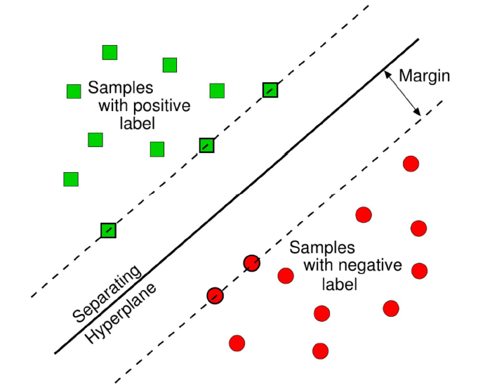
SVM
Finding the best decision boundary that will help separate the classes
hyperplane: <w,x> + b = 0
𝛿
Optimum decision boundary has maximum distance from closest points in each class i.e highest 2𝛿
The closest points are known as support vectors
2𝛿

Slide 8
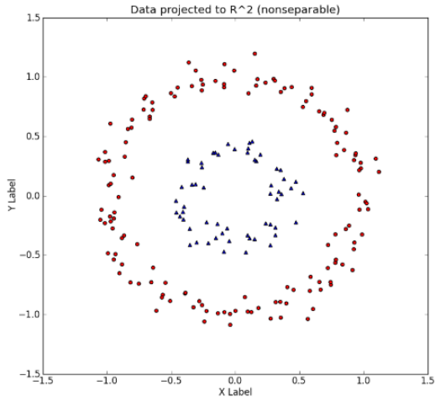
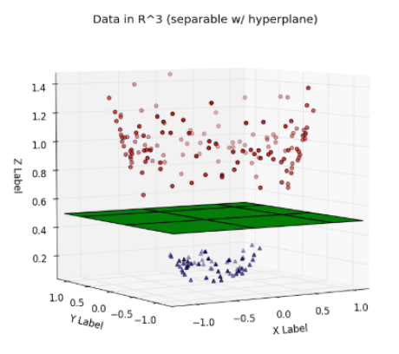
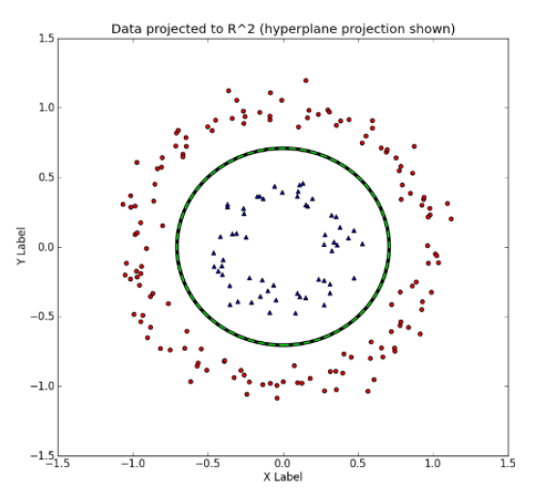

SVM – Kernel
If data is not linearly separable then linear classifier is not suitable
Project the data to higher dimension where it can be linearly classified
Kernel function allows computation in more efficient way
Linear
Rbf
Polynomial

Slide 9
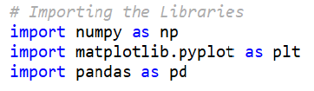
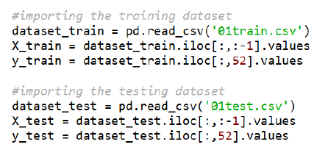
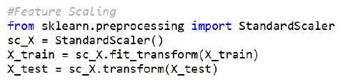
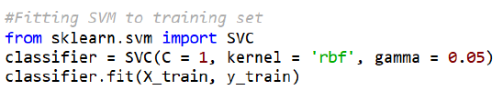

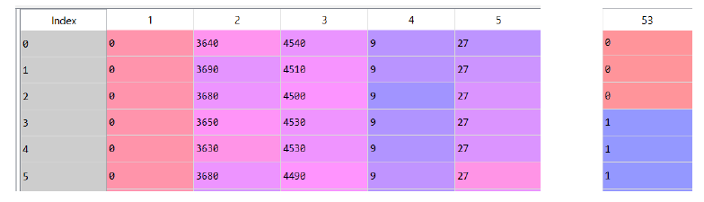
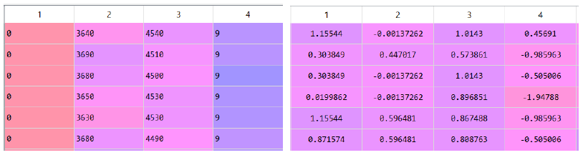
Implementation of SVM in Python
Importing the libraries
Importing the dataset
C
Kernel
Degree
Gamma
Feature Scaling
Building the model
Improving the model performance (Tuning the Hyperparameters)
Predicting the test set results

Slide 10
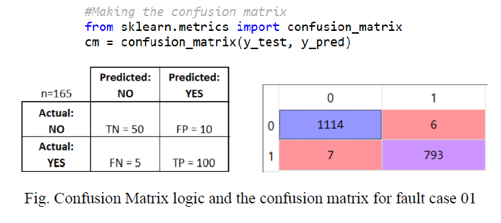
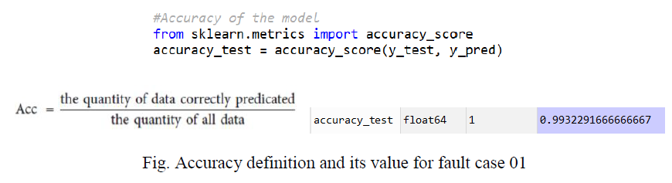
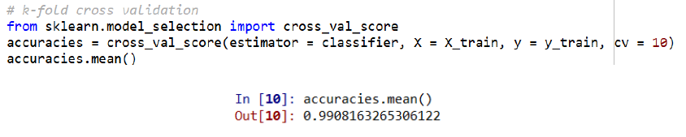
Performance Metrics
Confusion matrix and Accuracy on test set
K-fold cross validation

Slide 11
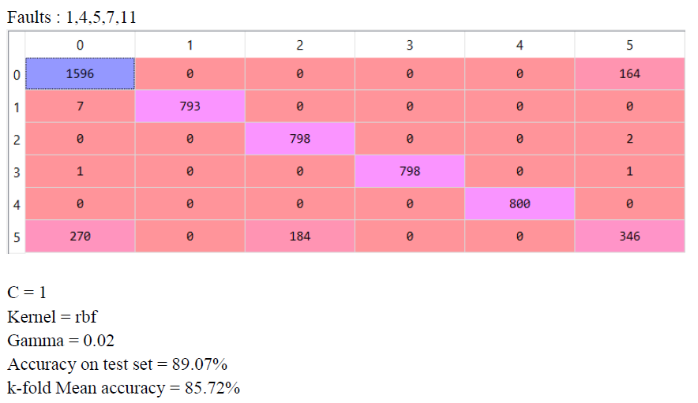
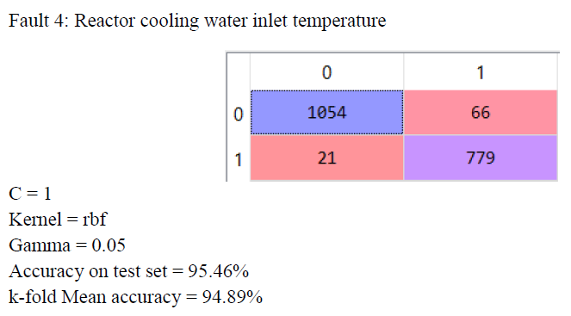
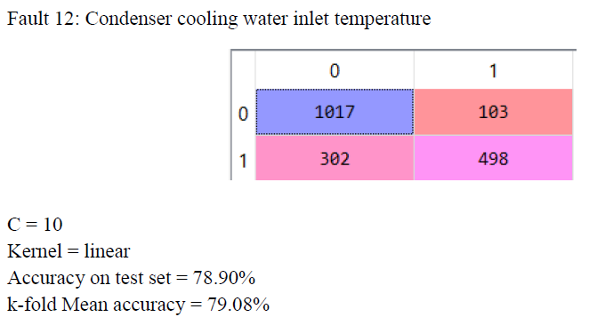
SVM Results for Fault Cases

Slide 12
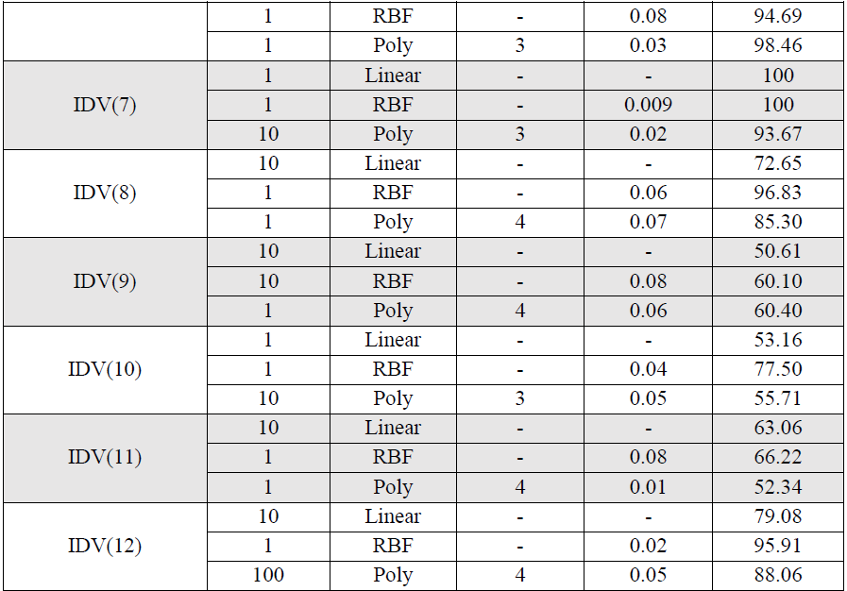
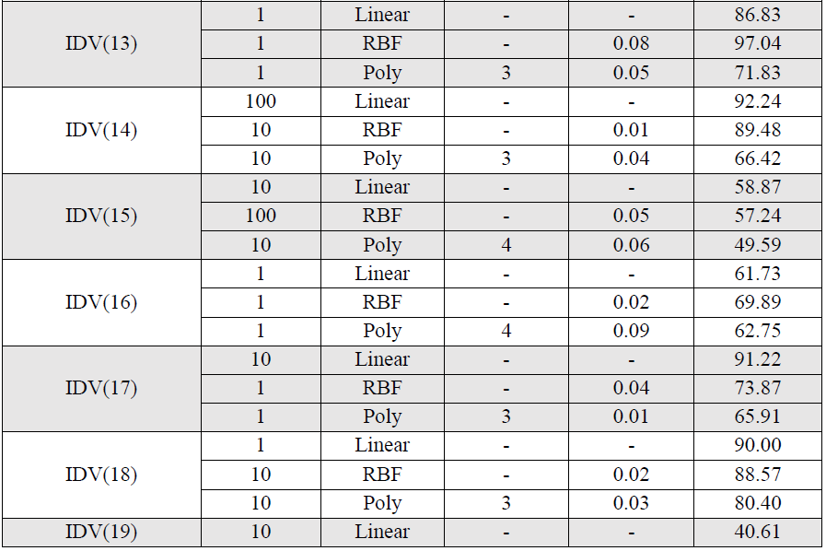
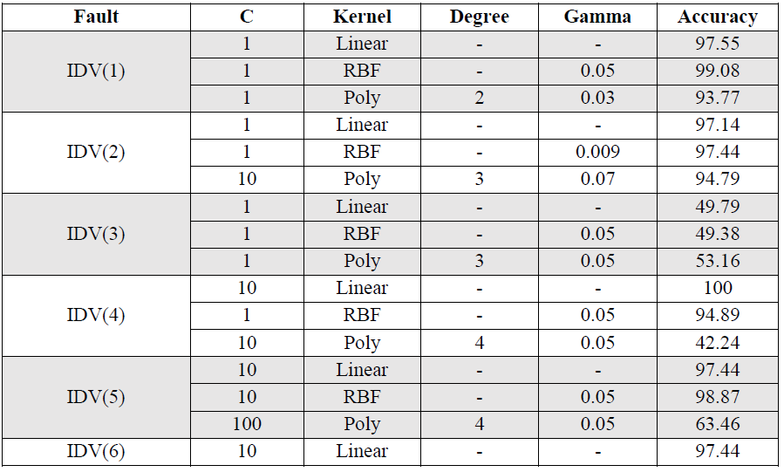
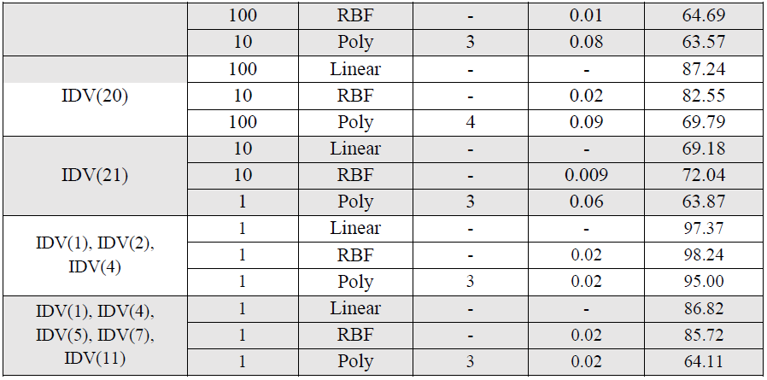

Slide 13
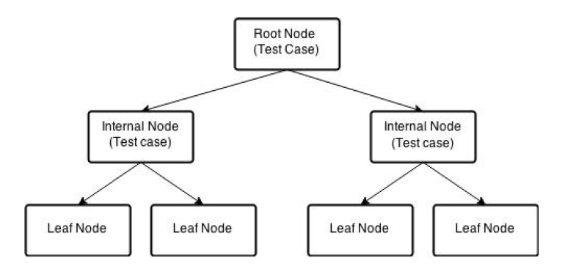
Decision Trees
The model uses if-then-else rules to interpret the value of target variable
Most important attribute is placed at root node
Data is split into subsets to get homogeneous sample
Final data attribute which cannot be classified further is known as leaf

Slide 14
Decision Trees – Splitting, Pruning
Splitting is done based on-
Information Gain: Difference in entropies
Gini Index: Quantifying amount of uncertainty (impurity) in data
Prone to overfitting due to excessive splitting of data
Pruning makes model simpler, generalized and avoids overfitting
Pruning done by reducing depth of tree by replacing bad branches (subtrees) by leaves

Slide 15
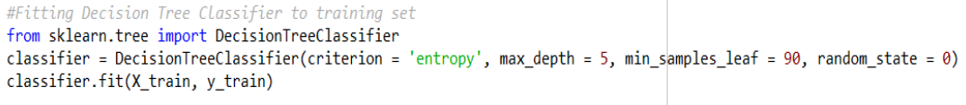
Implementation of Decision Trees in Python
Importing the libraries
Criterion
Max_depth
Min_samples_leaf
Importing the dataset
Feature Scaling
Building the model
Improving the model performance (Tuning the Hyperparameters)
Predicting the test results

Slide 16
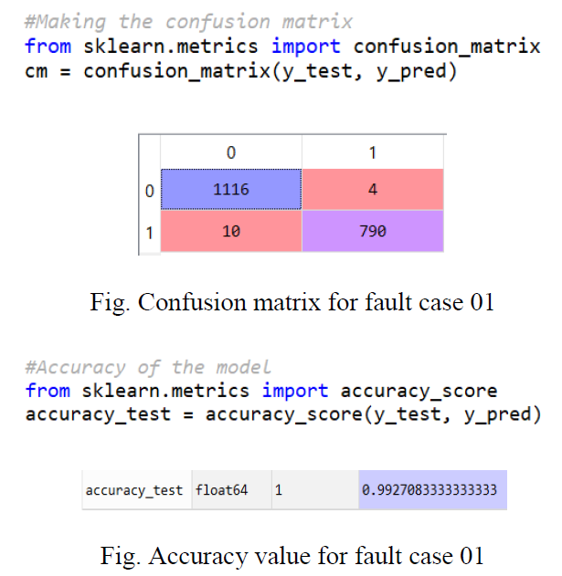
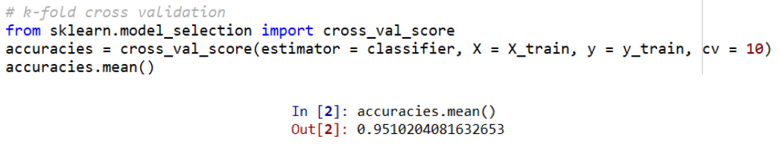
Performance Metrics
Confusion matrix and Accuracy on test set
K-fold cross validation

Slide 17
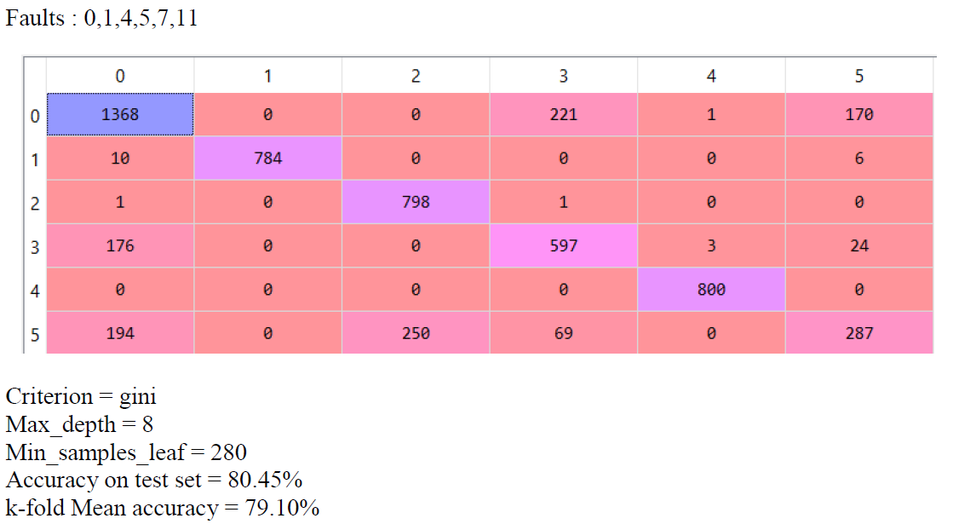
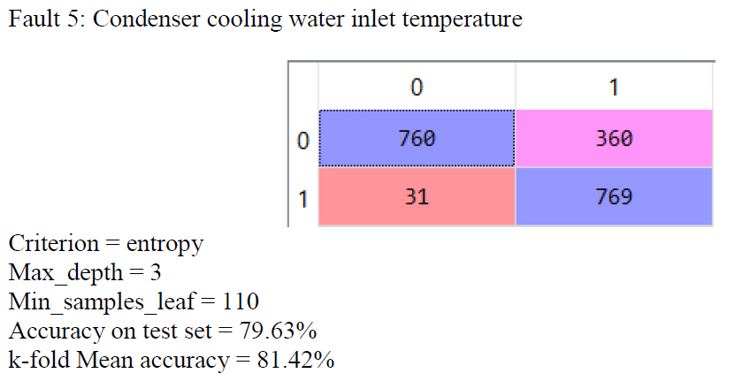
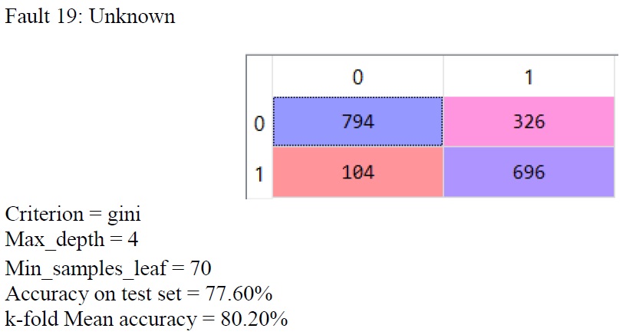
Decision Trees Results for Fault Cases

Slide 18
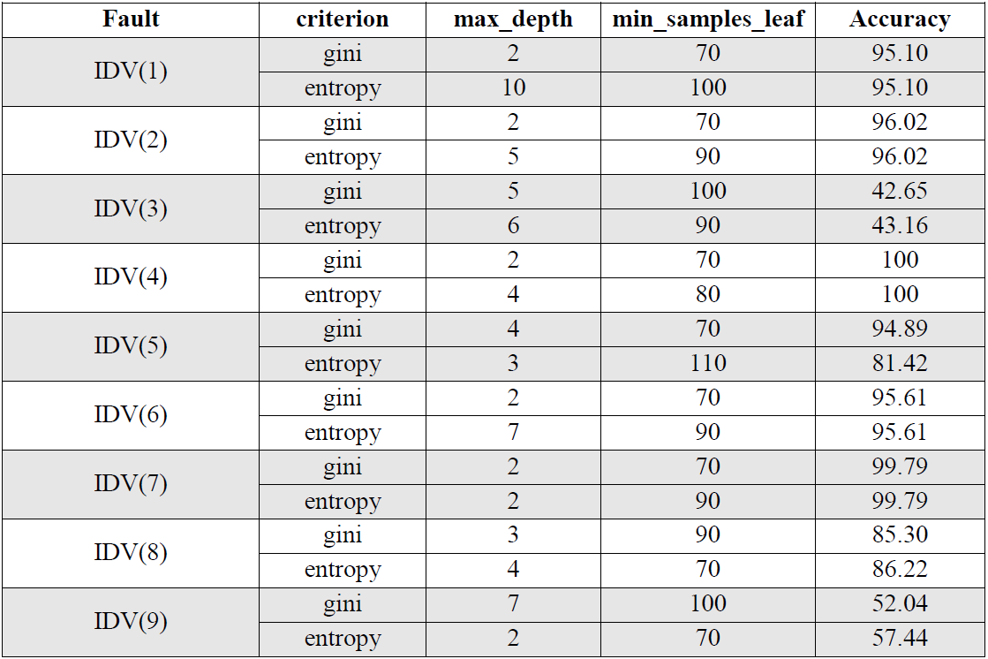
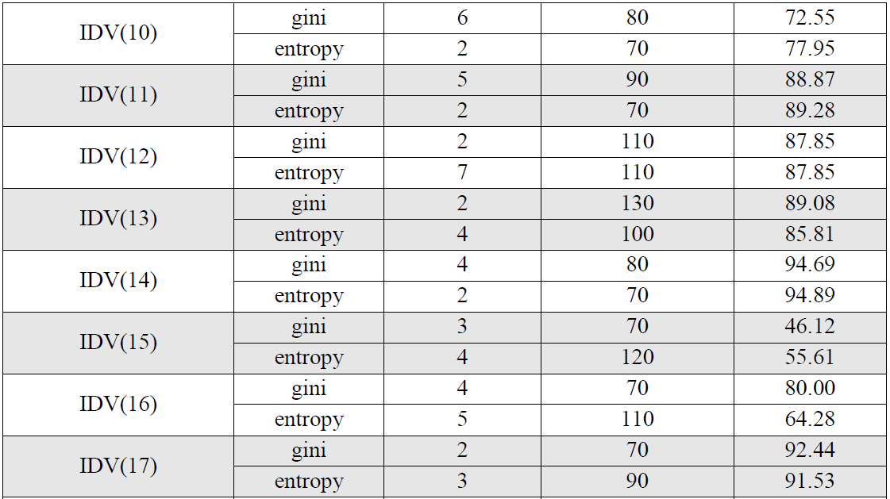
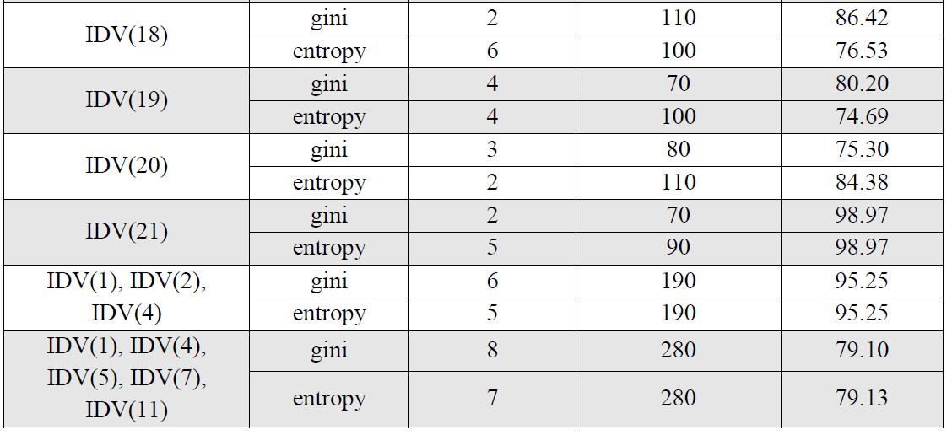

Slide 19
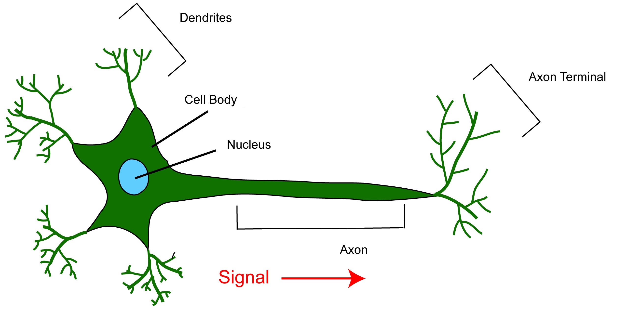
Neural Networks
Human Brain

Slide 20
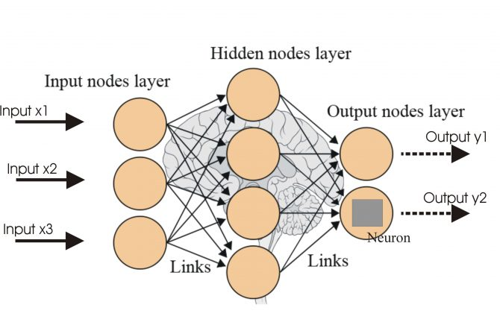
Neural Networks
Artificial Neural Network

Slide 21
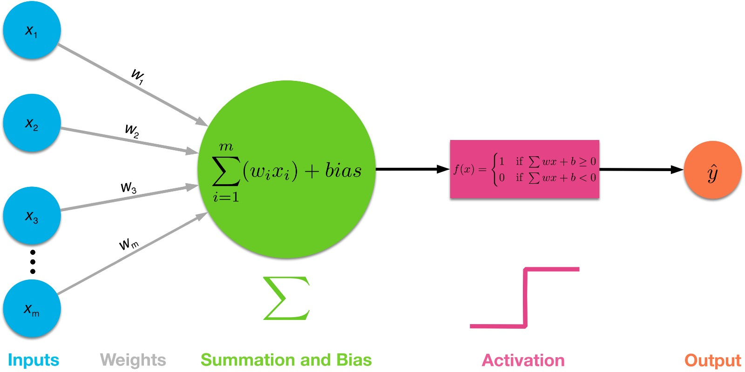
Neural Networks
Basic Working

Slide 22
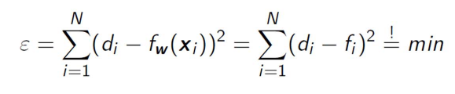
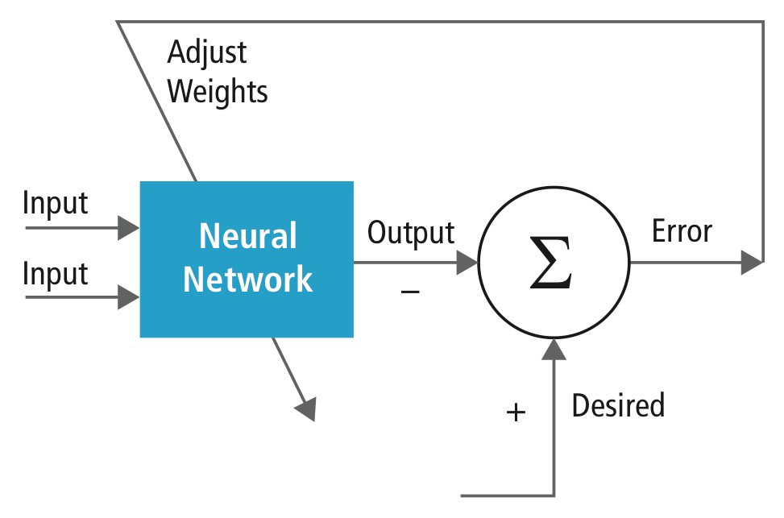
Neural Networks
Learning: W and θ are adjusted, to minimize the error

Slide 23
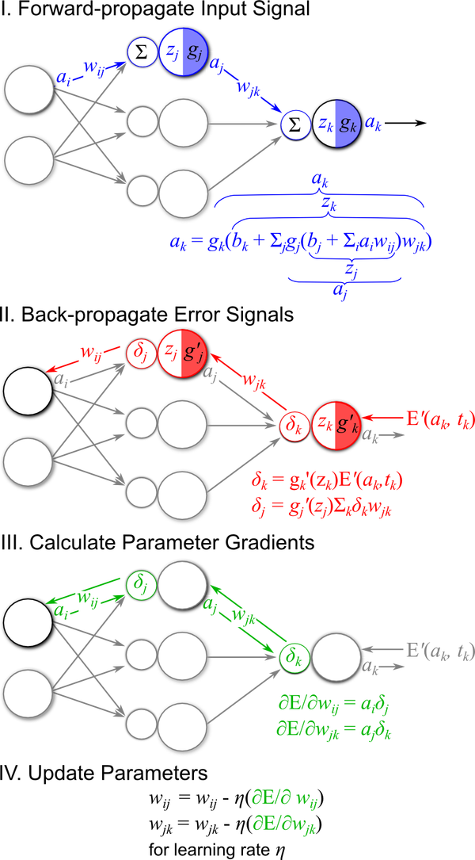
Neural Networks
Backpropagation

Slide 24
Implementation of NN in Python
1. Importing the libraries
2. Importing the dataset
3. Feature Scaling

Slide 25
Implementation of NN in Python
4. Fitting DNN to training set

Slide 26
Implementation of NN in Python
4. Fitting DNN to training set
- Classifier: Sequential
Layer: Dense
1. Output Dimension = 26
2. Init = Uniform
3. Activation = ReLu (for Hidden Layers) & Sigmoid (for Output Layer)

Slide 27
Implementation of NN in Python
4. Fitting DNN to training set
Compiling the ANN
1. Optimizer = adam
2. Loss = Binary Crossentropy
3. Activation = ReLu (for Hidden Layers) & Sigmoid (for Output Layer)

Slide 28
Implementation of NN in Python
4. Fitting DNN to training set
Fitting the ANN to the training set
1. Batch Size = 10, 40, 100
2. Epoch = 100

Slide 29
Implementation of NN in Python
5. Predicting test results

Slide 30
Implementation of metrics to measure performance of DNN
1. Confusion Matrix
For Fault 1

Slide 31
Test and Validation Results for Fault Cases
Fault 1,4,5,7,11 (Combined) (for Batch Size 10)

Slide 32
Test and Validation Results for Fault Cases
Fault 1, 2, 4 (Combined) (for Batch Size 10)

Slide 33
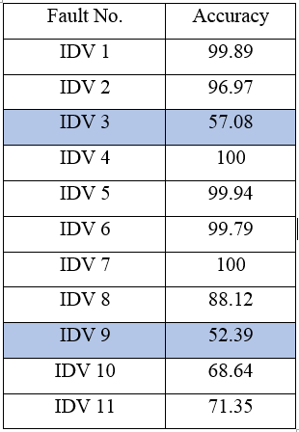
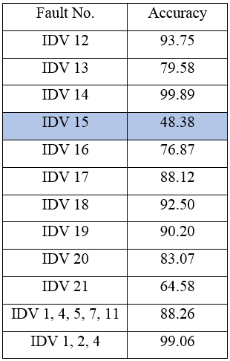
Test and Validation Results for Fault Cases

Slide 34
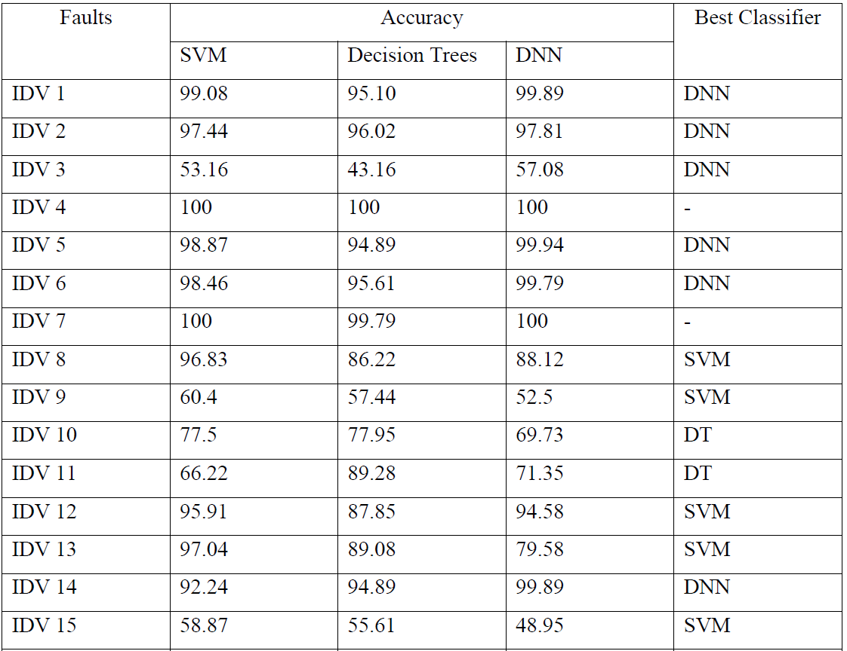
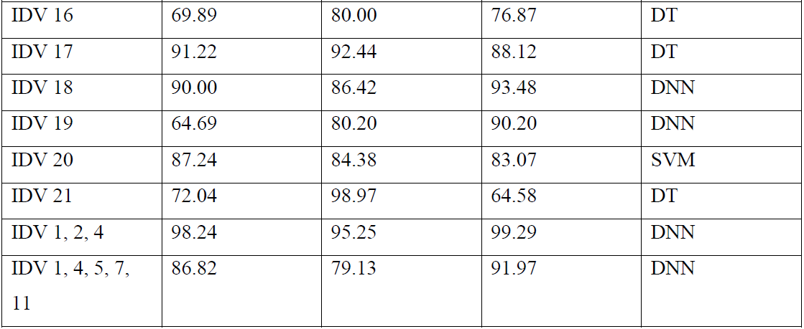
Detailed Comparison
In General:
SVM | Decision Trees | Deep Neural Network
Not biased by outliers Kernel SVM has high performance on non-linear problem | No need of feature scaling Works on both - linear and non-linear cases | Different algorithms can be used for training
Not the best choice for large number of features | Poor results on too small dataset Prone to Overfitting | Require large dataset and computational power

Slide 35
Conclusion
The performance of all three classifiers is above the baseline accuracy in all fault cases except 3, 9, 11 and 15.
The accuracy of classifiers decreases with increase in number of class labels.
On comparing the performance, it can be concluded that Deep Neural Network model gives the best accuracy in most cases followed by the SVM and Decision Tree respectively.

